Slide 1
STATE Pattern
There are times when we find some scenarios in our application when we need to maintain the state of a sub system. This state needs to be changed based on some conditions and/or user actions. One way to keep track of such states is by using the conditional logic in code.
Using conditional logic will get us the desired result but that would result in a code that is less understandable and is harder to maintain.
To tackle such problems efficiently we have State pattern. It "Allow an object to alter its behavior when its internal state changes. The object will appear to change its class."

Slide 2


Let us try to implement the software for a dummy ATM machine. The ATM machine is with us and the Bank has decided to have 3 states for this machine.
No card in the machine
Card inserted and has been validated
Cash withdrawn
4256 0420 0840 0420
PAPPU GANDHI

Slide 3
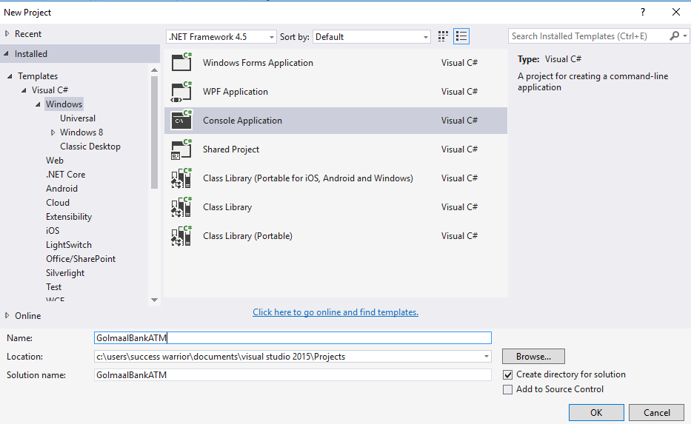

Slide 4
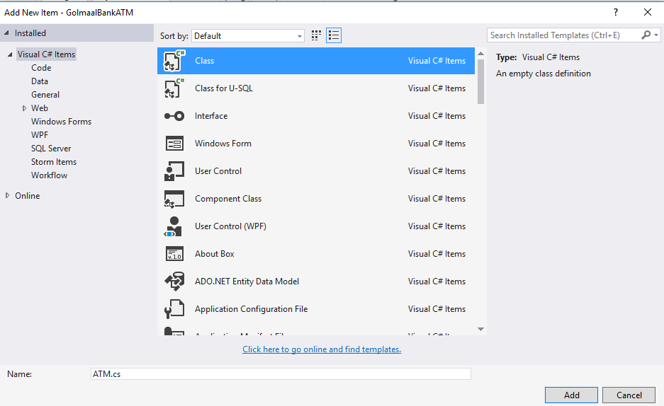

Slide 5
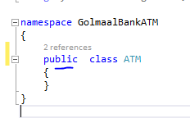

Slide 6
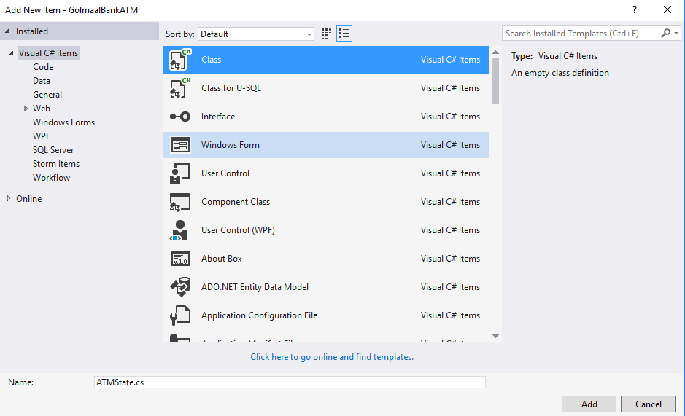

Slide 7
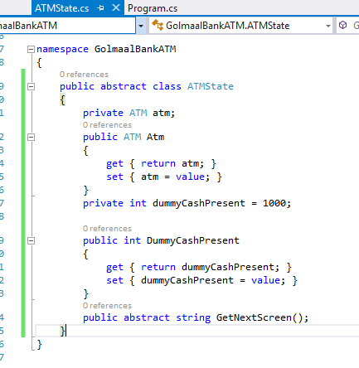

Slide 8
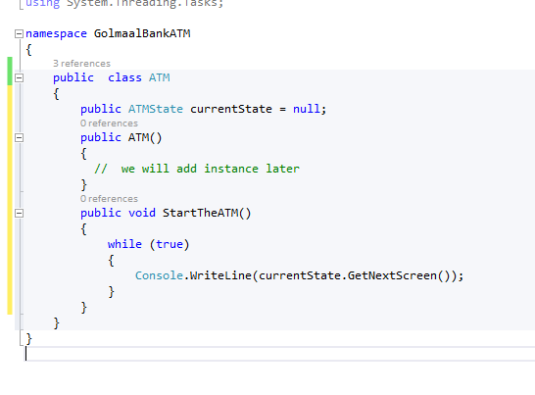

Slide 9
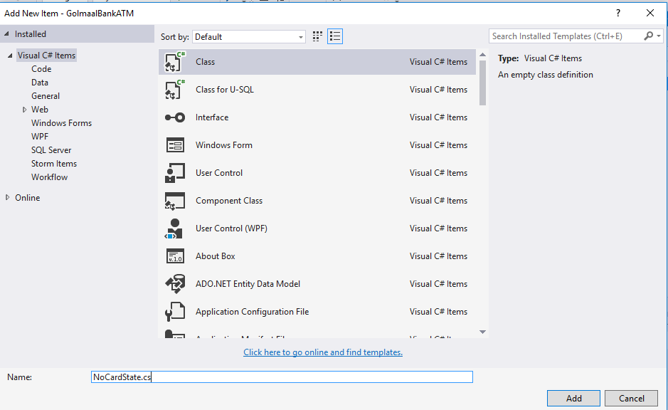

Slide 10
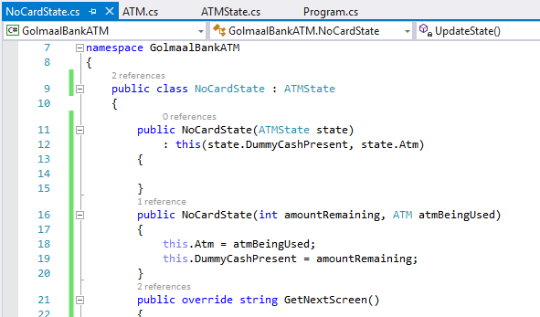

Slide 11
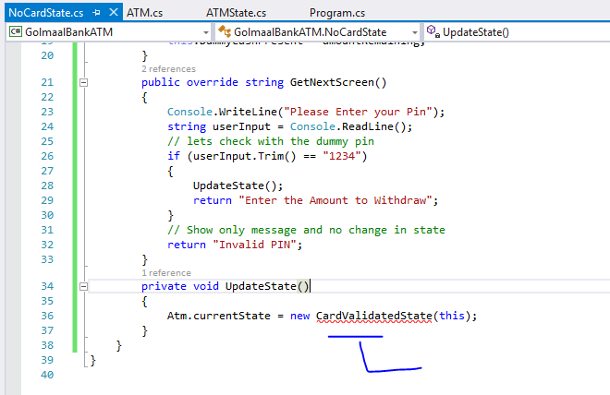
Next step

Slide 12


Slide 13
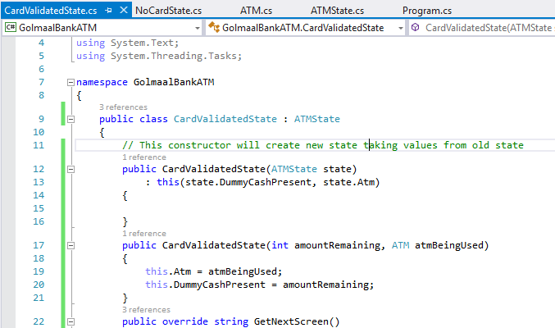

Slide 14
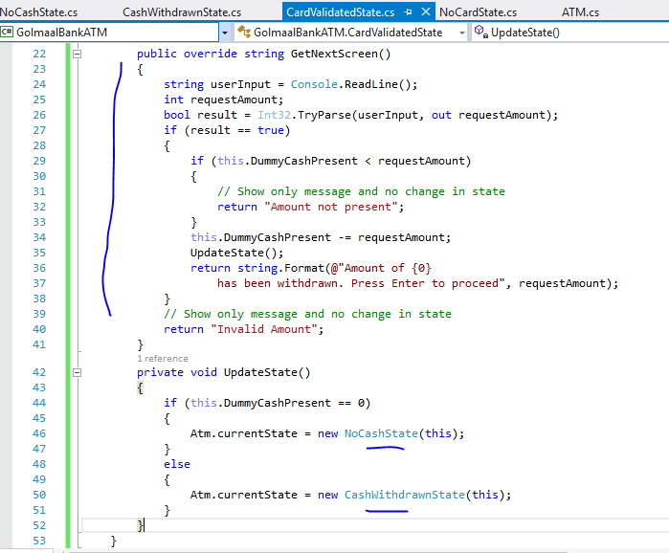

Slide 15
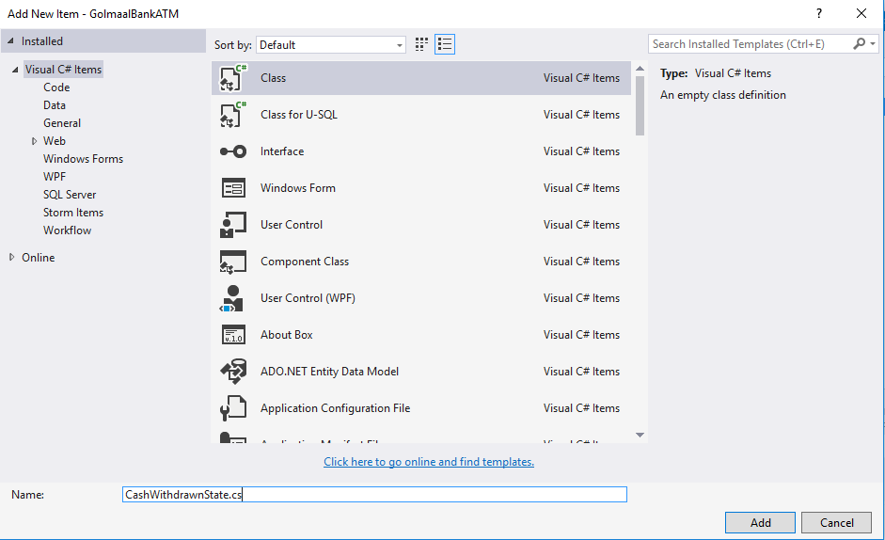

Slide 16
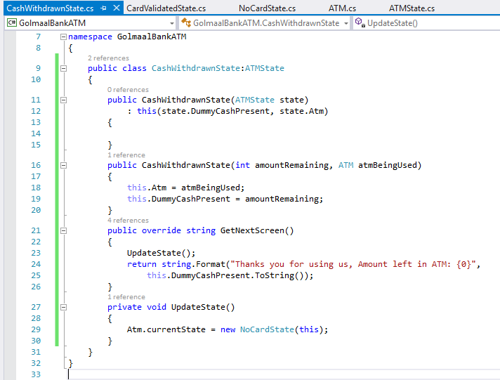

Slide 17
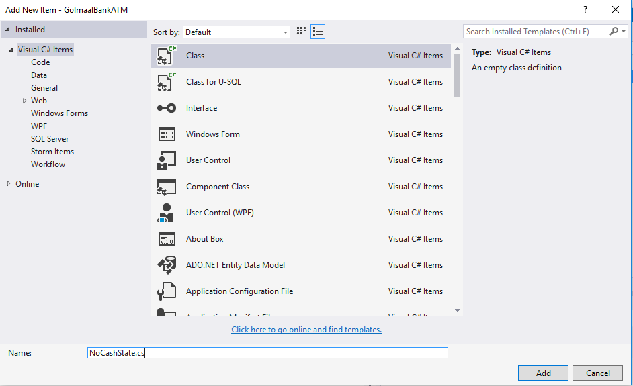

Slide 18
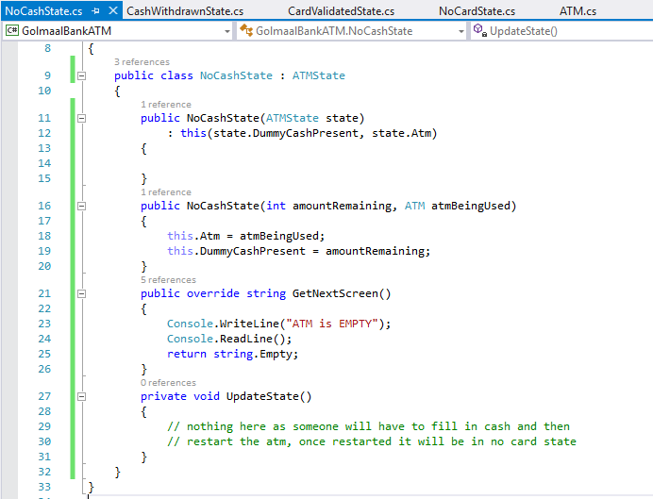

Slide 19
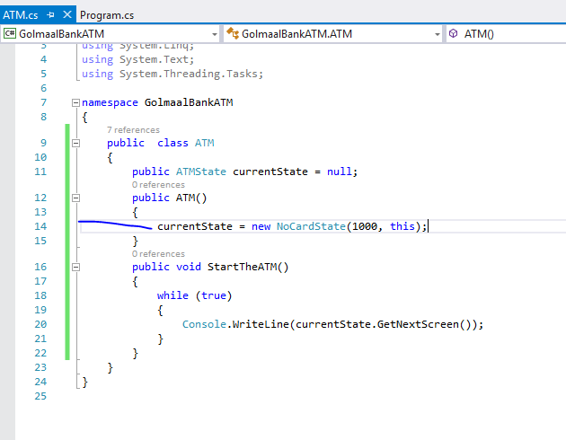

Slide 20
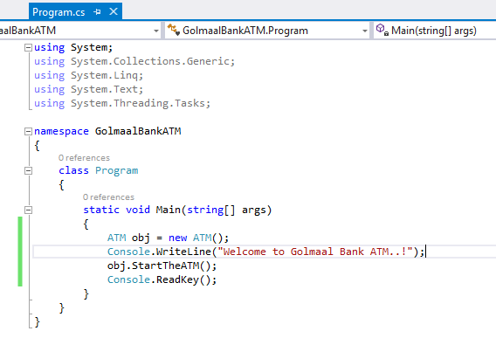

Slide 21
